Slide 1
DS 302
DESIGN PROJECT
“Design and Fabrication of rain protector for Two-wheeler”
Under the guidance of :-
Dr. Tushar Choudhary
Submitted by:-
Group - 34
Arpit Kumar Pandey ( 2018038)
Pranav Choudhary (2018184)
Shivam Singh (2018372)
Sayooj M K (2018528)
Raja Diwakar (2018202)

Slide 2
Introduction
Most of the two-wheeler riders face problems during rainy season. Even though they use raincoats there are still problems in using it, and those who use rain covers also faces problems. So in this project we are going to identify those problems and come up with a suitable solution for them.

Slide 3
PROBLEM IDENTIFICATION & OBJECTIVE
PROBLEMS
OBJECTIVE
We conducted customer survey by interview and direct observations. We also collected information through our own experience and found the following problems that the users face.
The products available in the market are very eye catching and flashy.
Using raincoats would dirty or wrinkle the dress.
For ladies, it is uncomfortable to sit on the back seat with a raincoat on.
Currently there is no suitable rain protector for motor bikes in the market.
The products in the market are less durable.
To redesign a rain protector for two wheelers that is durable, less flashy, and comfortable to sit inside.

Slide 4
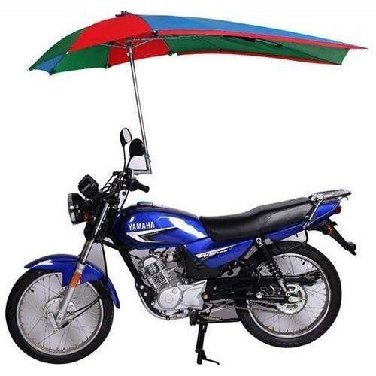
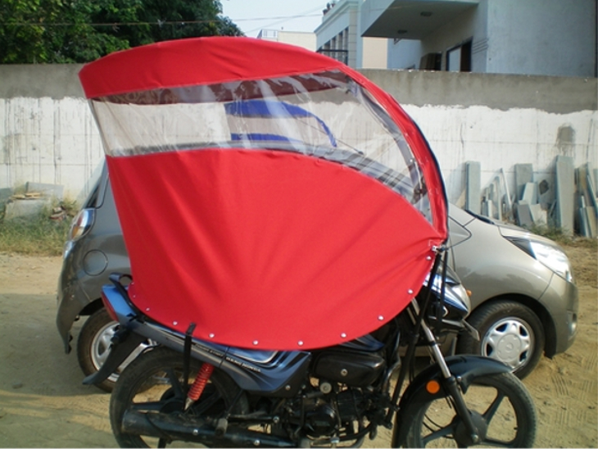
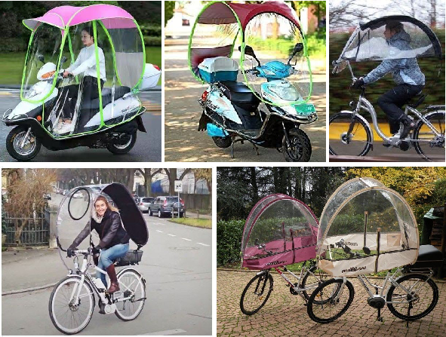
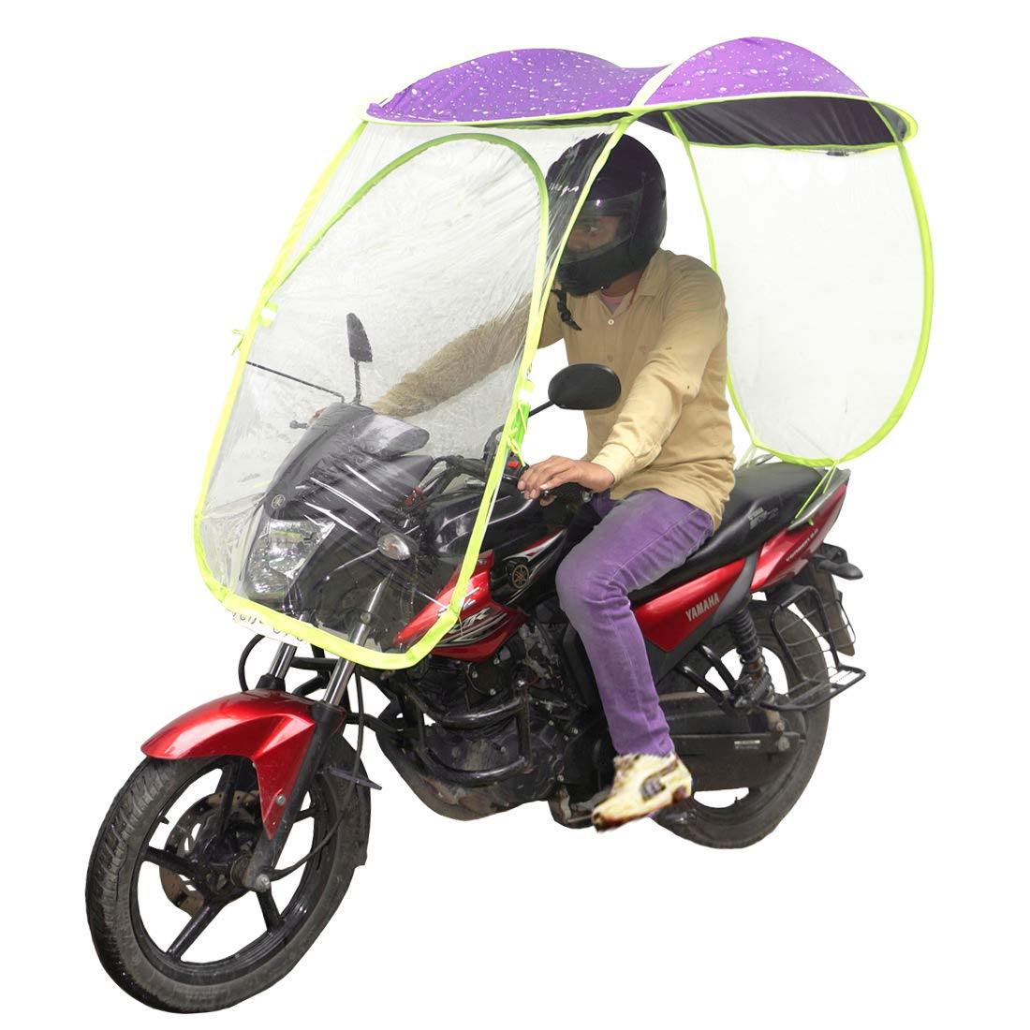
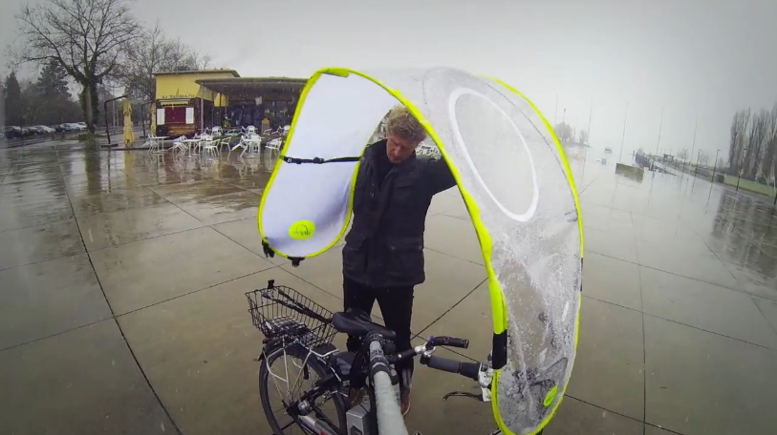
STATE OF ART

Slide 5




METHODOLOGY ADOPTED
Surveying and observation:
We surveyed the problems faced by people using two wheelers, interviewed them and also made a note of the ones we observed.
Product survey:
We also surveyed the market for various products currently available to help us innovate
Persona:
We made personas from the data collected for better understanding of the user’s needs.
Brainstorming:
Brainstorming was done for getting better and innovative ideas.

Slide 6
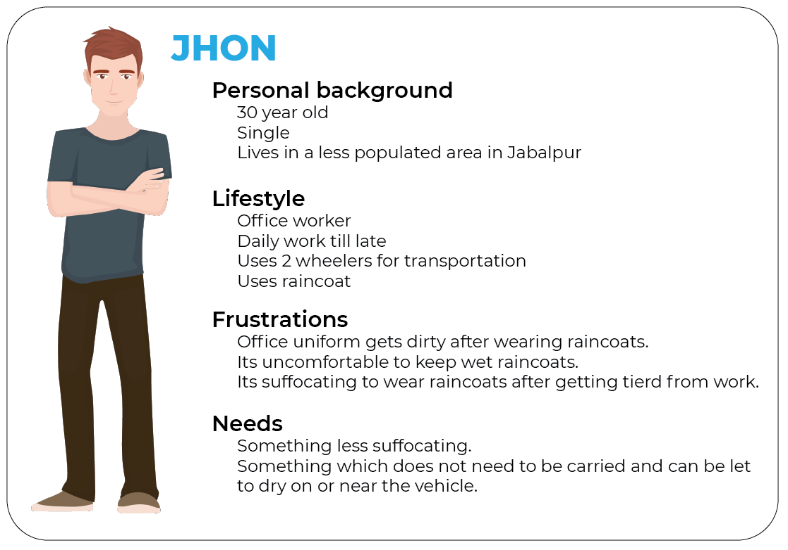
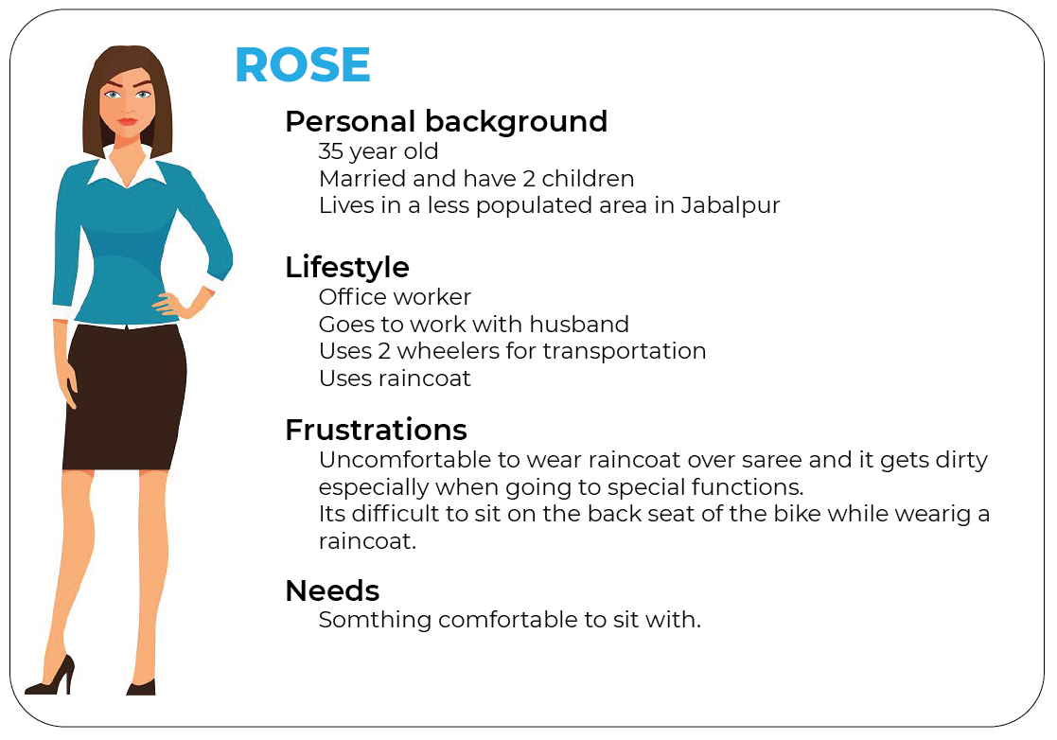
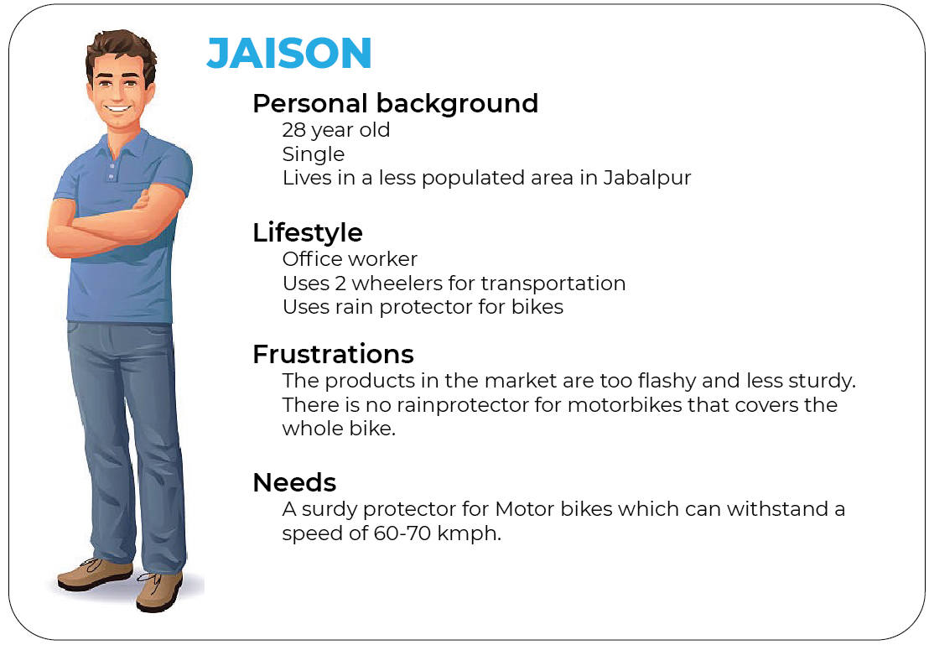
METHODOLOGY ADOPTED
From the data we obtained after the user study we created a persona for better understanding of the user’s needs.

Slide 7
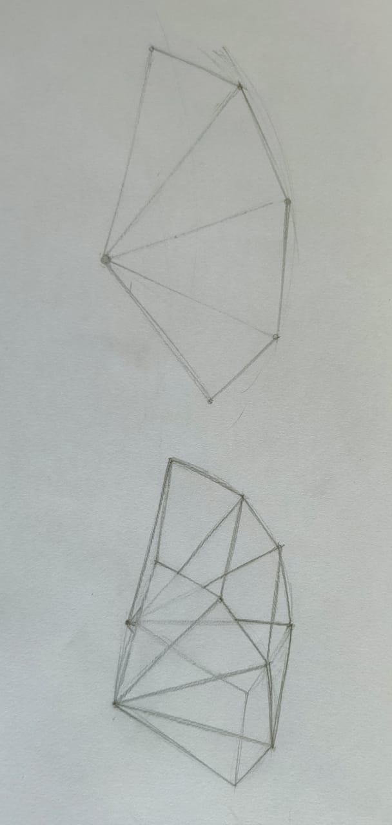
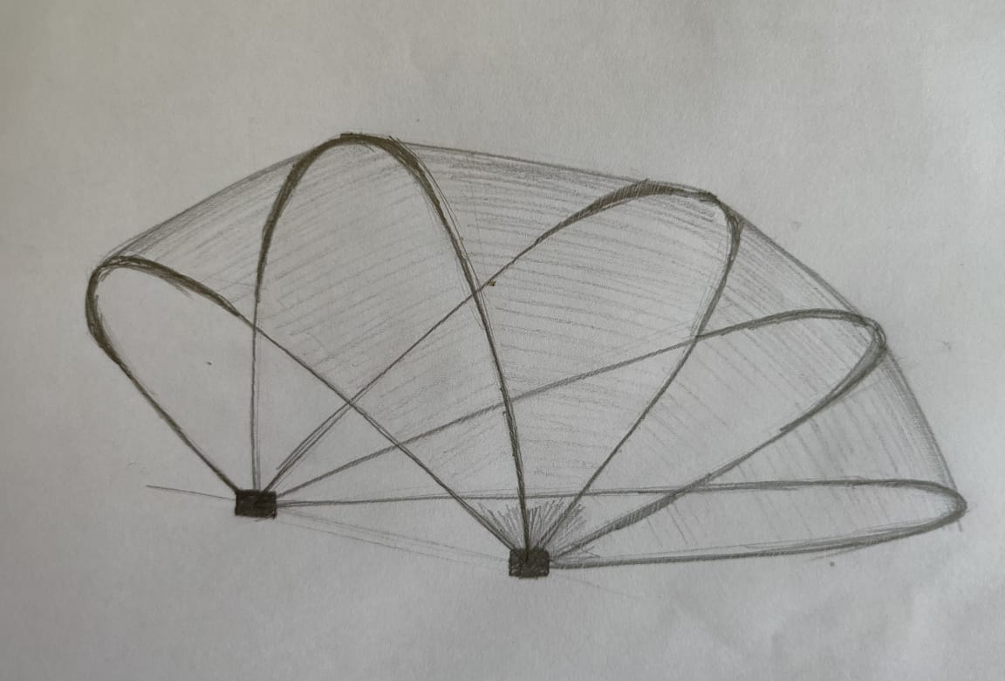
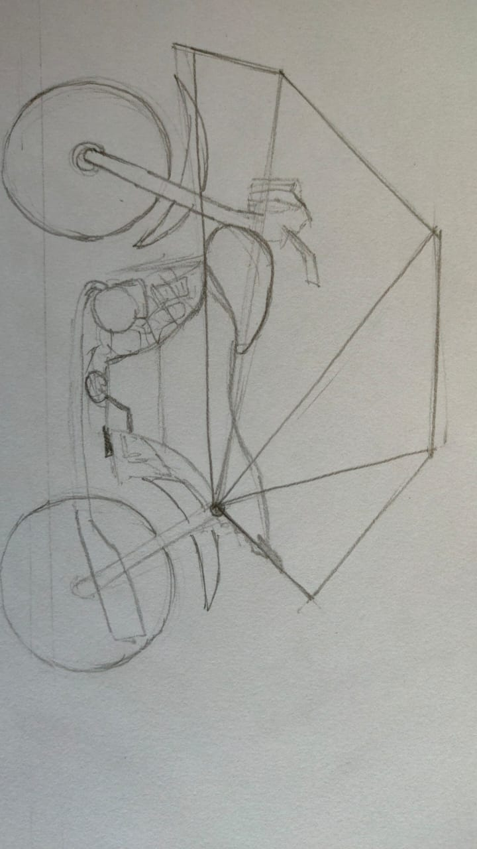
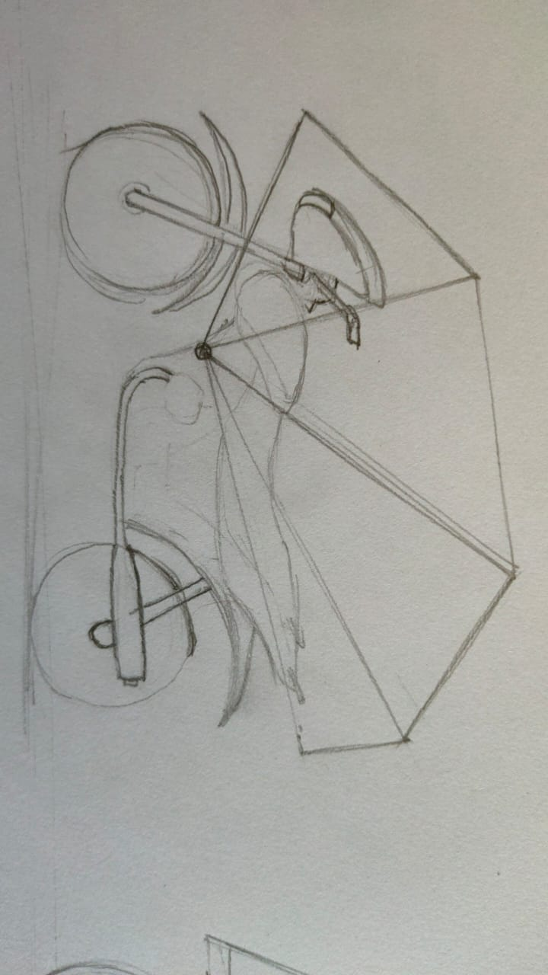
PROPOSED SOLUTION
After re analyzing and removing non compatible solutions we obtained a design.
MATERIALS USED
Aluminium frame
Modellable plastic
Waterproof polyester coated silver nylon and Pongee
Polyurethane laminate
Nuts and bolts
Adhesives
After refining this idea we came up with the final design.
UI Design: We also prepared a design of the User Interface of a marketing app for the product for better marketing service for the product.

Slide 8
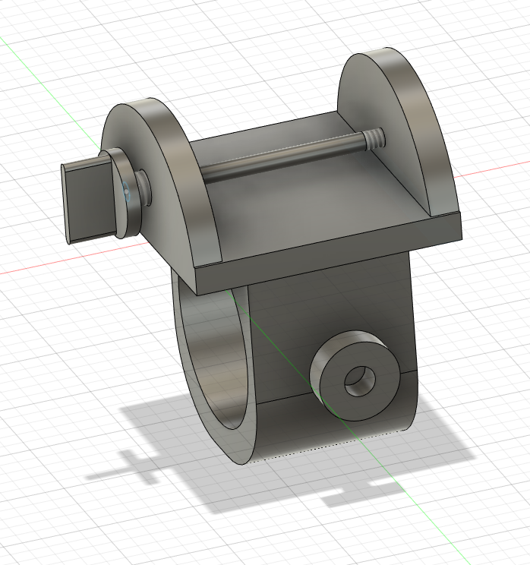
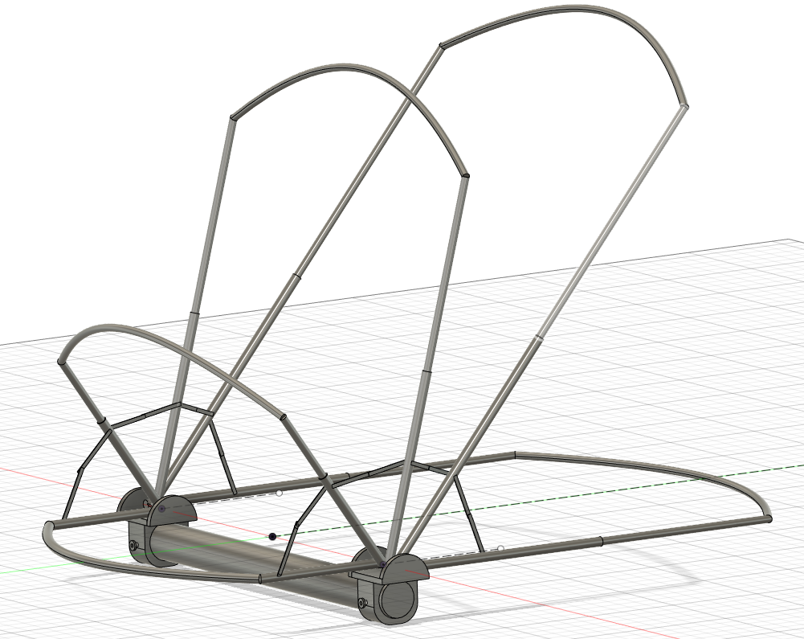
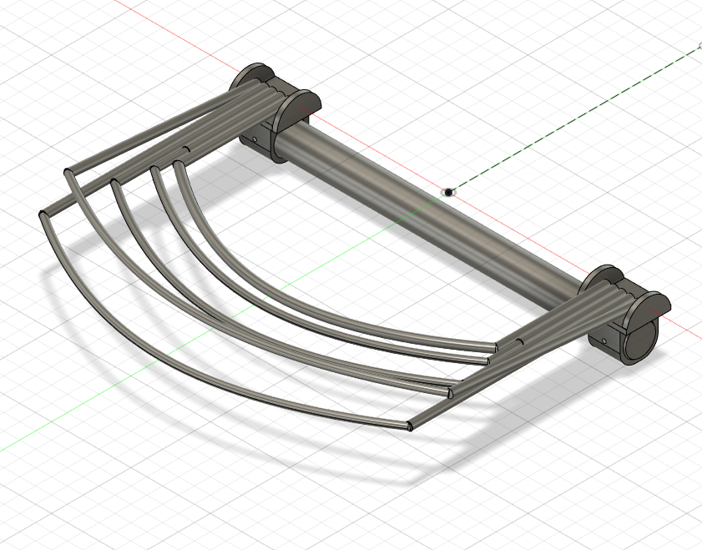

Slide 9
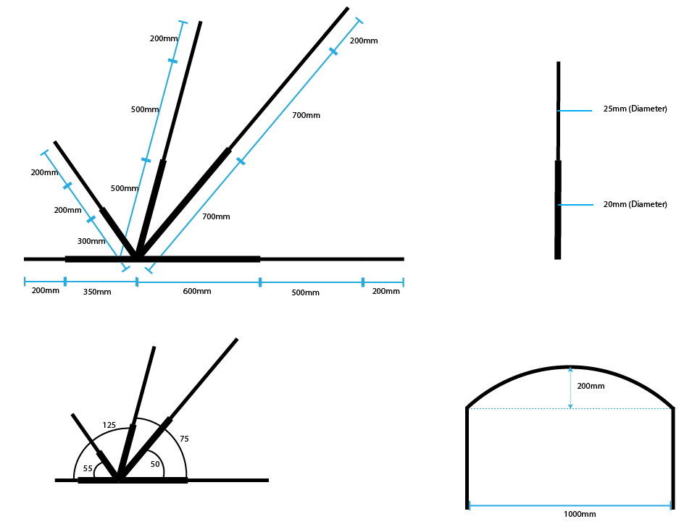
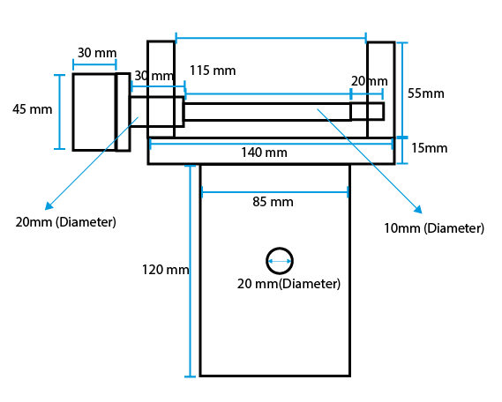
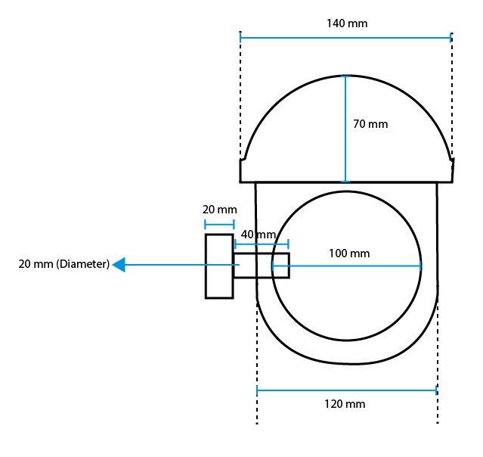
DIMENSIONS

Slide 10
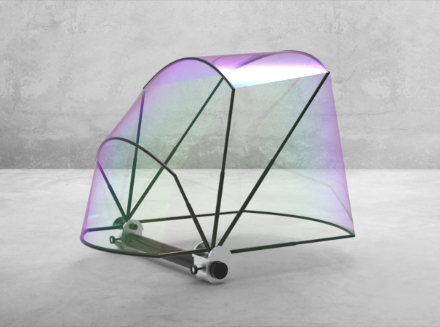
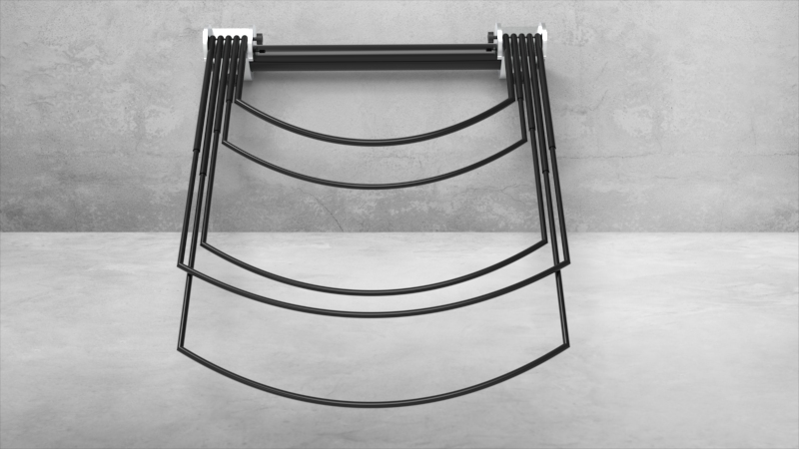
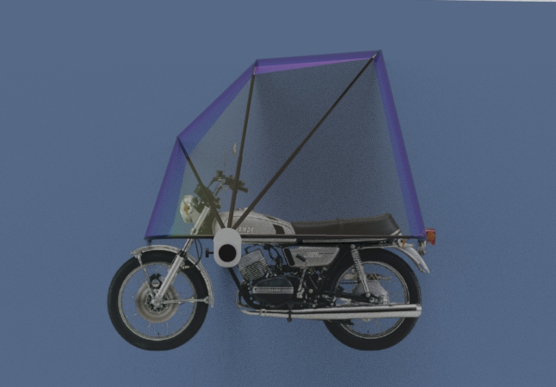

Slide 11
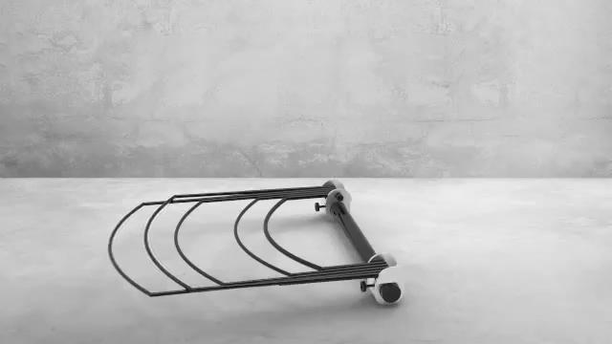
SIMULATION

Slide 12

SIMULATION

Slide 13
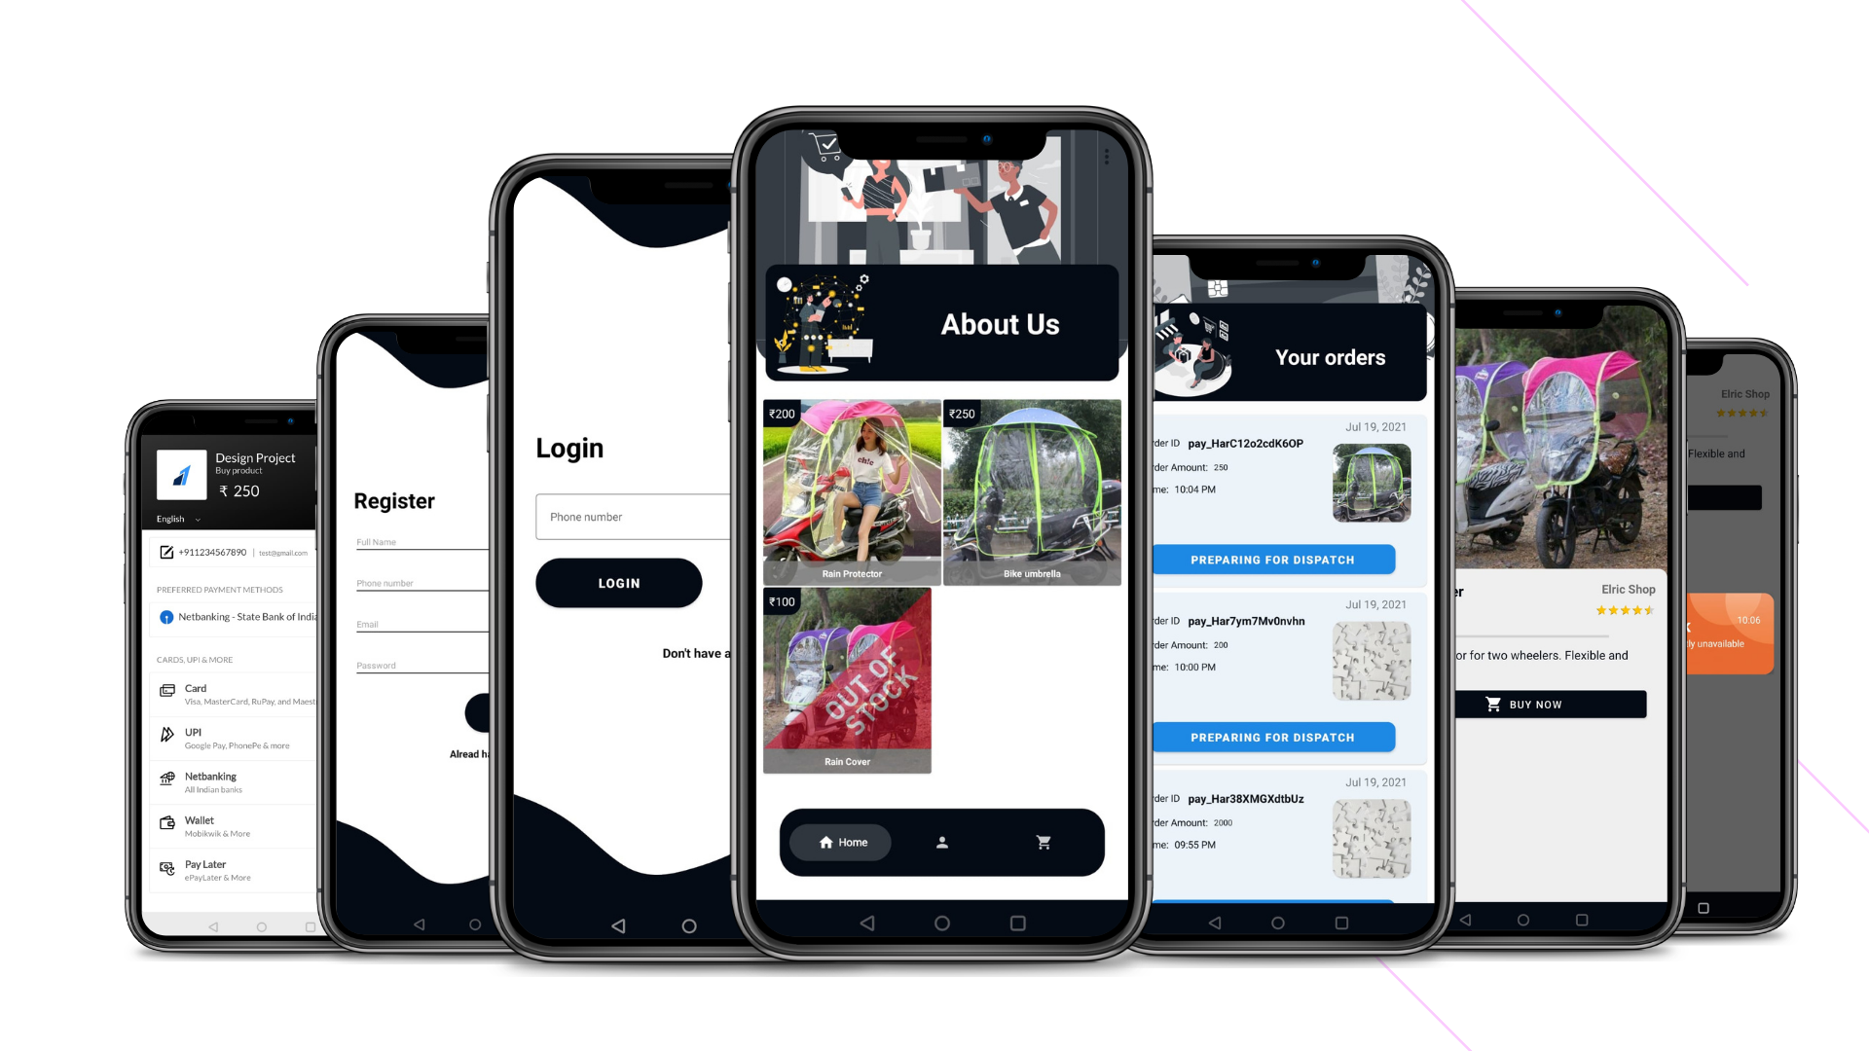
MARKETING

Slide 14
KEY FEATURES
ROOM FOR IMPROVEMENT
Contractible and multiple fold frame for easy and compact use.
Sturdy and less air resisting design which can withstand a speed of 60-70 Kmph.
Comfortable and enough space to accommodate two passengers
Can be locked from the driver’s seat.
Suitable for Motor bikes
After practical testing the following improvements may be possible.
Increase the number of folds on each frame.
Decrease the diameter of the frames.
Decrease the number of frames.
Adding rain drop sensors to automatically open rain protector.

Slide 15
Novelty and Patentability
Our rain-protector has contractible and multiple fold frame which takes less space when closed and provides enough space while open.
The app interface and ideology is original and has no resemblance to any other app.
This idea will help people using two-wheelers also they don’t have to worry about carrying it with them as it can be locked with vehicle itself.
This is the most sturdy design of rain protector currently available.
The theoretical work regarding design and conceptualization of the rain protector has been done and the concept is ready for implementation.

Slide 16
THANK YOU

